Slide 1
“See I am doing something new! Now it springs forth. Can you not perceive it?”
Isaiah 43:19

Slide 2
Pastoral Planning Prayer
Good and gracious God, we prayerfully come to you and request your guidance as our Catholic community unites together as one to create the pathway for the future of your faith filled family.
You have called upon us to use our God-given gifts to listen, to understand, to inspire, and to joyfully work together as we create a new pastoral plan that welcomes opportunities to strengthen and invigorate our God-filled community.
Please Lord, let us overcome any barriers and challenges that could separate us and let us be unafraid to embrace the changes You reveal to us.
We ask this in the name of the Father, Son, and Holy Spirit. Amen.
Written by Paulette Widmann

Slide 3
Changing Circumstances
Our churches are not being populated by waves of immigrant Catholic communities
Our neighborhoods are not being filled with Catholics
The surrounding popular culture propagated by various media is largely unchristian

Slide 4
“What is our mission now?”
“Our Facts” and “Today’s Facts”

Slide 5
Our Facts
Attendance is declining by 4.5% each year; down 53.2% since 2002
Offertory is not keeping up with expenses.
Our population is aging; most parishioners are age 70-79.
Survey results

Slide 6
Today’s Facts
Emotional needs
People are hurting.
Need to feel valued, heard, and loved.
Intellectual needs
A need to be understood and to understand.
A need to be challenged.
Relational Needs
The local church is essential for God’s people.
We must be attentive to the needs of shut-ins, widows, and single adults
Spiritual Needs
We have the answer to people’s spiritual needs. But if their emotional, intellectual, and relational needs are not being met, will they hear us?

Slide 7
How do we Plan to Face the Facts?
We must act now so we can do so with relative freedom. Be proactive, not reactive.
We cannot just continue with what is comfortable and familiar until we and Catholic life in Meadville die.

Slide 8
We must bring together all of our strengths.
3 pieces of a puzzle. Without your help the picture will not be complete

Slide 10
Pastoral Planning Process for Catholic Community of Meadville
Facilitator- Sister Clare Marie Beichner, SSJ

Slide 11
Catholic Community of Meadville
Who is involved?
Parishioners
Pastoral Leaders
Priests, Deacons, Staff Task Force
Notes:
Catholic Community of Meadville
Catholic Community of Meadville
Parishioners
Pastoral Leaders – Pastor and Parochial Vicar
Assisting Deacons –
Deacon Edward Hornaman
Deacon Ken Reisenweber
Deacon Todd Sommers
Office of Evangelization and Faith Formation
Office Staff
Parish Staff

Slide 12
Task Force
Paulette Widmann – Chair of Pastoral Council
Steve Mizner – Chair of Finance Council
Staff: Amy Mosbacher, Sarah Blood
Pastoral: Father Lucas and Father Boyd
St. Agatha: Alan Flick, Sheryl Justin, Amy Mosbacher, Paulette Widmann
St. Brigid: Kathy Buzza, Lois Curtin, Annette Lynch, Steve Mizner
St. Mary: Tim Hunter, Bob Pears, Carl Pelino, Susan Trucco, Sarah Blood

Slide 13
Pastoral Planning Process
Three Phased Process
Facilitator
Parish Plan
Task Force

Slide 14
Phases of Pastoral Planning
Phase One – Vision
Determine the future direction and growth of the Catholic Community of Meadville
Notes:
Phase One
Determine the future direction and growth of the Catholic Community of Meadville
We know good planning requires good data.
Data provides an objective assessment of the current situation.
It helps us see how we are changing, who we are serving and where we can grow.
You will hear tonight some of what we learned so far.

Slide 15
Phases of Pastoral Planning
Phase Two
Implementing faith formation initiatives to support the spiritual growth and proclamation of the Gospel
Use Key Indicators for a Vibrant Parish
Parish Life Surveys
Determine what will be best for us
Notes:
Phase Two
Implementing faith formation initiaitives to support the spiritual growth and proclamation of the Gospel

Slide 16
Phases of Pastoral Planning
Phase Three
Assessing role of the physical plant
Thorough study of buildings, mechanical equipment, and other structures
Accessibility, need, functionality
Needs now and projected into the future

Slide 17
Phases of Pastoral Planning
Phase Three - “Space follows function”
Typical needs to consider:
Worship space
Fellowship Space – Gatherings, Dinners
Meetings space and classes
Office Space
Notes:
Phase Three will only be considered after consideration of other two phases

Slide 18
Steps Tonight
Share Information – Presentations
Table Talk - Small Group Discussion
Large Group – Gather all Input
Next Steps – Task Force

Slide 19
Catholic Community of Meadville Listening Session
Paulette Widmann
Pastoral Council, President
December 4, 2019

Slide 20
“The parish is where the Church lives. Parishes are communities of faith, of action and of hope. They are where the gospel is proclaimed and celebrated, where believers are formed and sent to renew the earth. Parishes are the home of the Christian community; they are the heart of the Church. Parishes are the place where God’s people meet Jesus in a word and sacrament and come in touch with the source of the Church’s life.”
USCCB document,
Communities of Salt and Light, Reflections of the Social Mission of the Parish.

Slide 21
Guiding Vision:
To create a unified spiritual community guided by the Holy Spirit to glorify Jesus Christ through worship, prayer, education, celebration and evangelization.

Slide 22
Listening Session
So why are we here?
Given the statistics and current trends we must embrace the realities.
We must create the pathway for a meaningful, viable future.
We must make way for something new for the future.
“Without a vision, are you left only to perish?” -Proverbs 29:18

Slide 23
What is your vision for the future?
We are here to listen.
We will provide you information and then gather your input.
No decision has been made.
Your input, including survey results, is key to process.
Process requires trust from everyone and to stay focused on our mission and a vision for planning.

Slide 24
Why are we here?
We must stay positive.
Church faces many challenging issues today.
We are focused on our Catholic community.
If other topics arise, we will gently steer the room back to the purpose of this meeting.
Our planning is a Three Phase Process that will evolve over the next several months.
Our vision will not occur overnight.

Slide 25
Parish Survey Results
Amy Mosbacher and Alan Flick

Slide 26
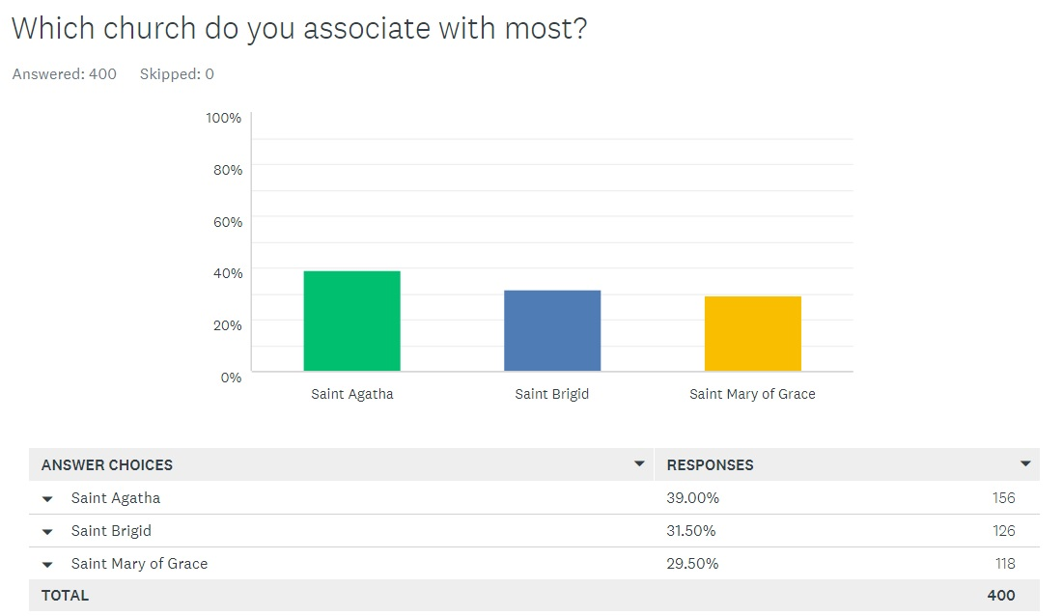

Slide 27
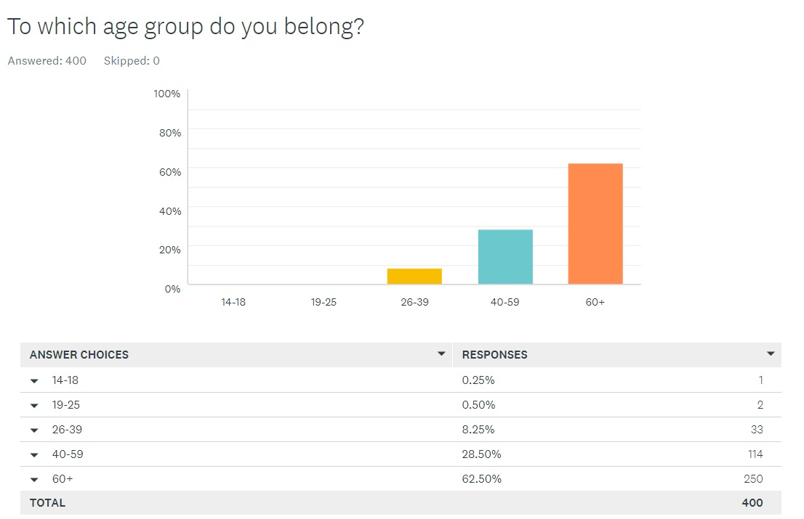

Slide 28
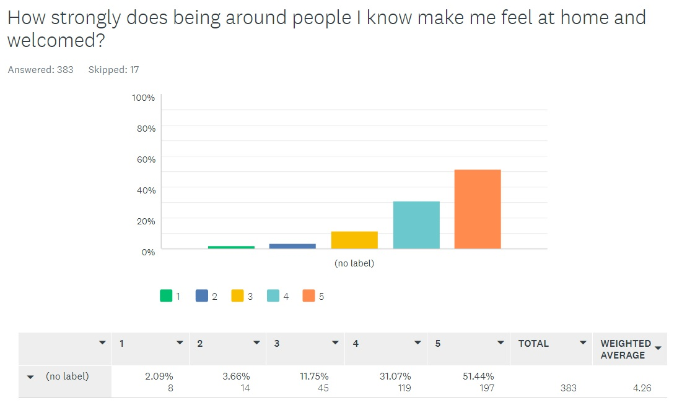

Slide 29
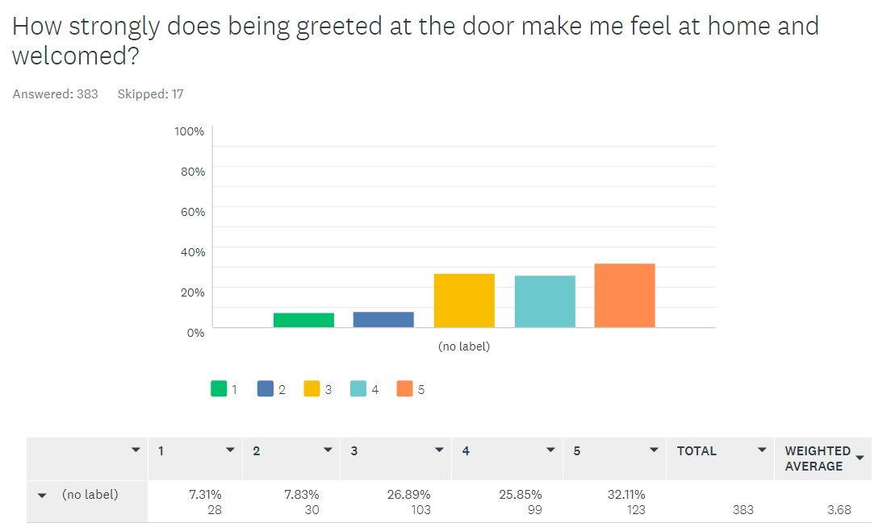

Slide 30
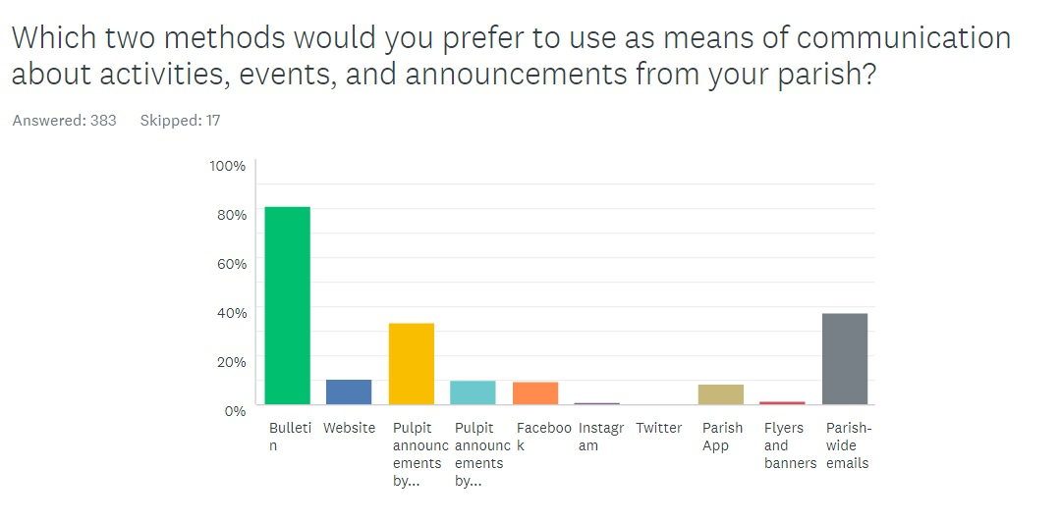

Slide 31
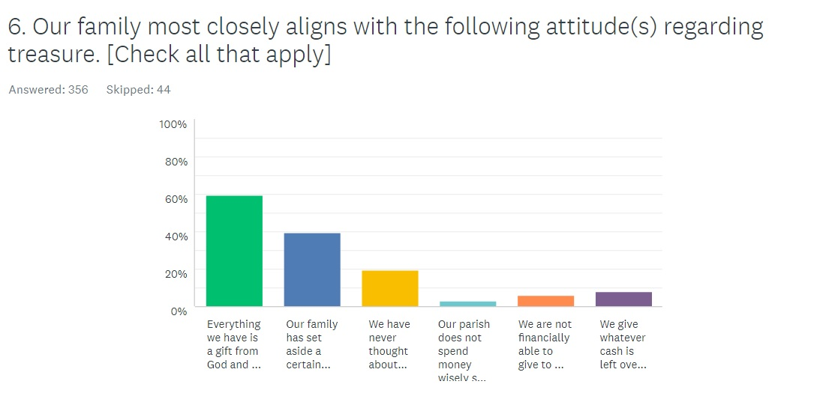

Slide 32
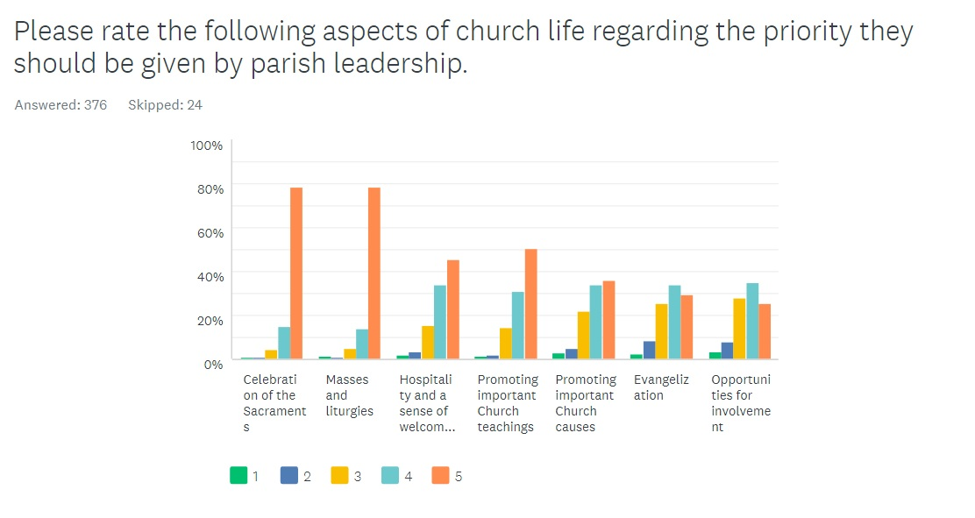

Slide 33
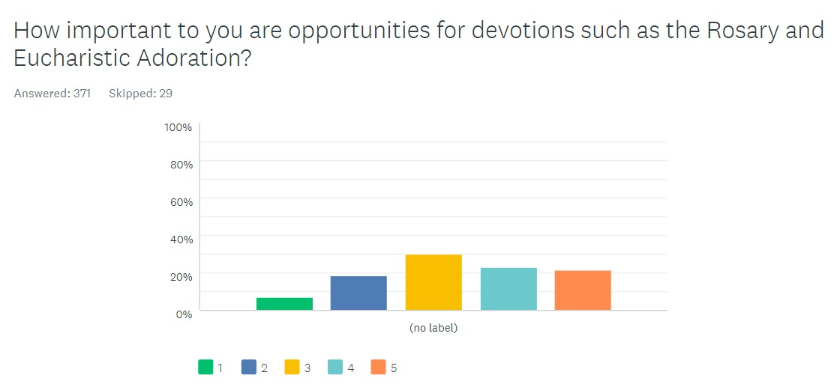

Slide 34
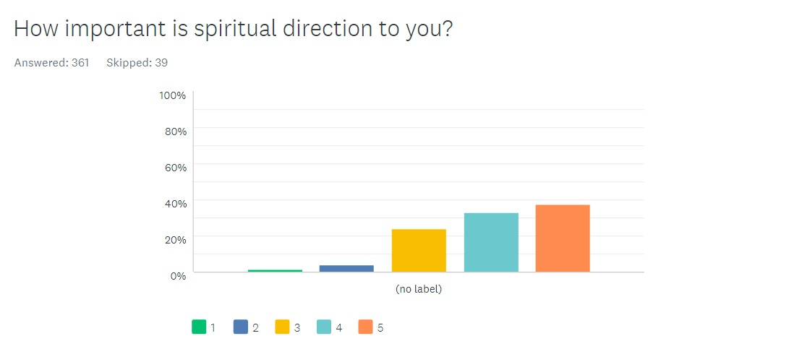

Slide 35
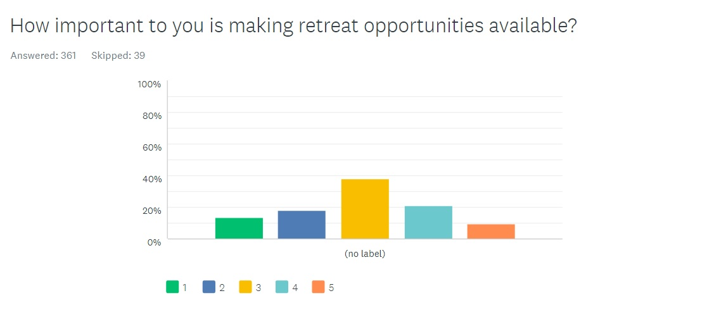

Slide 36
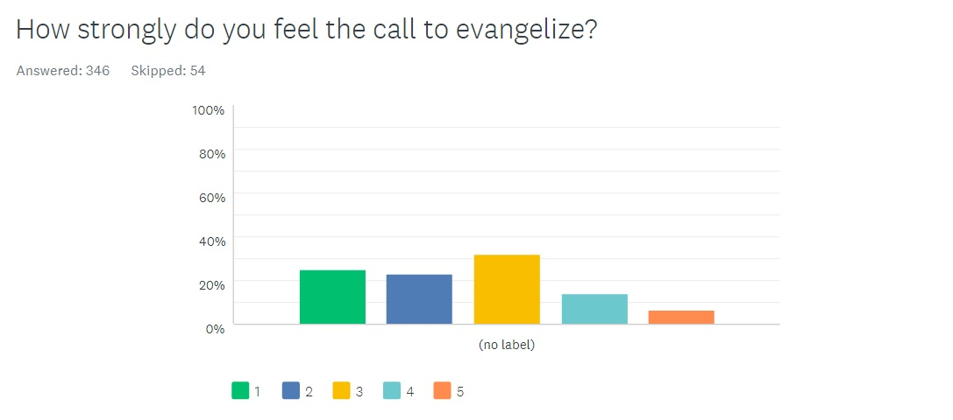

Slide 37
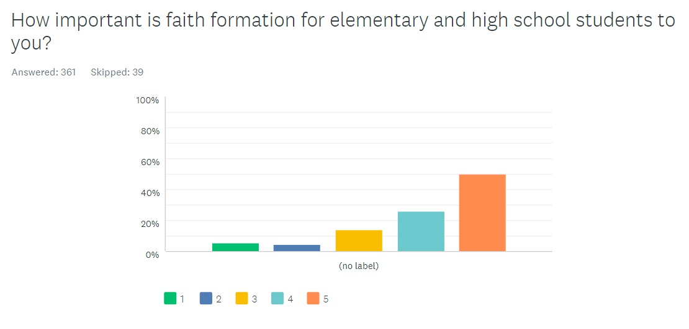

Slide 38
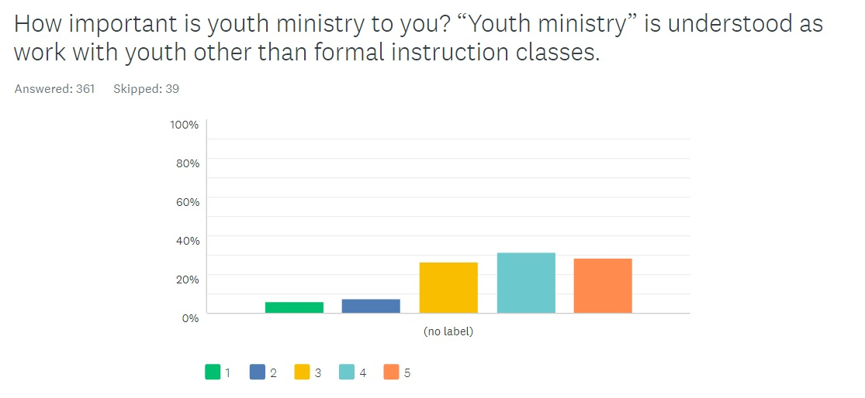

Slide 39
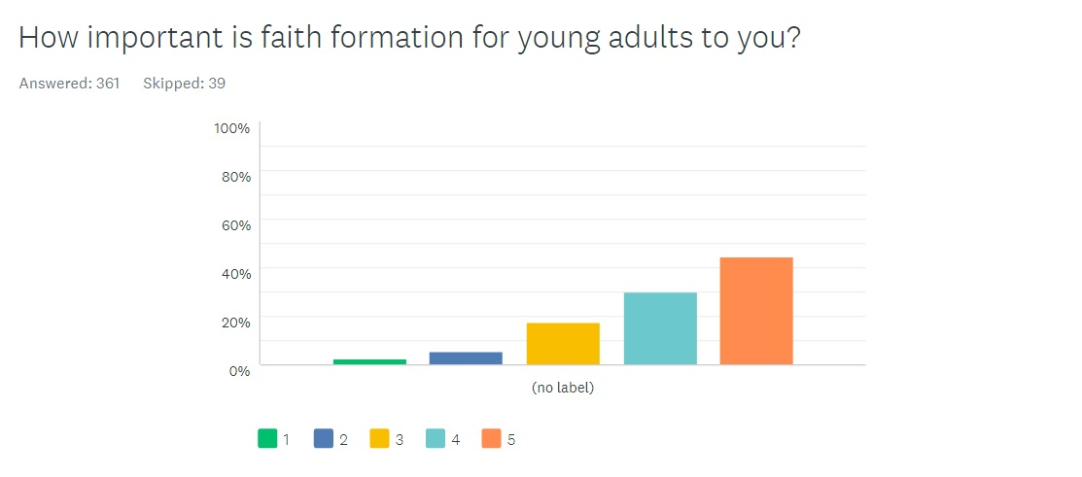

Slide 40
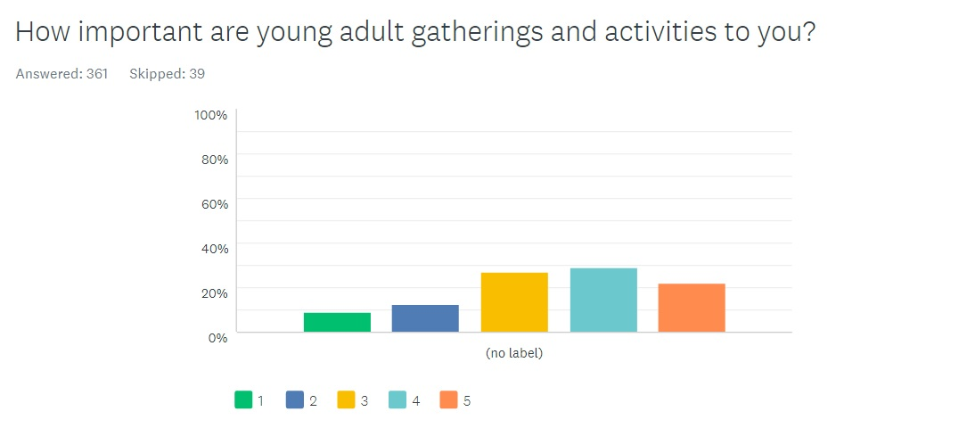

Slide 41
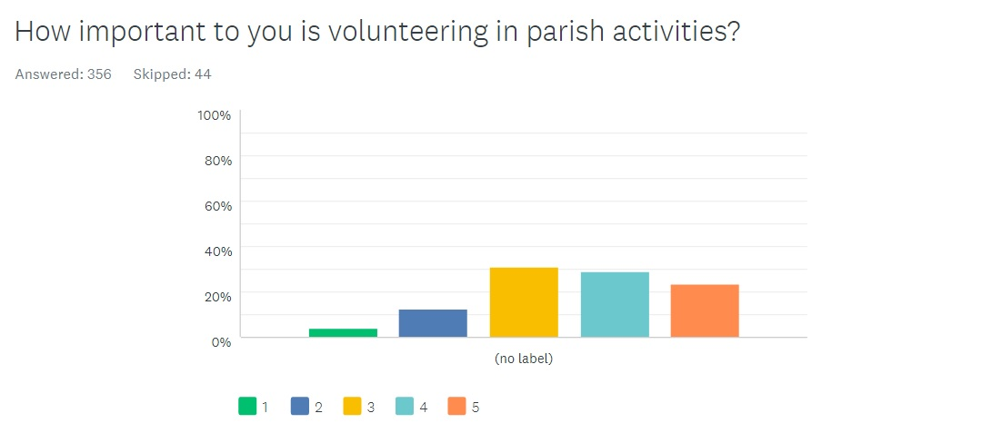

Slide 42
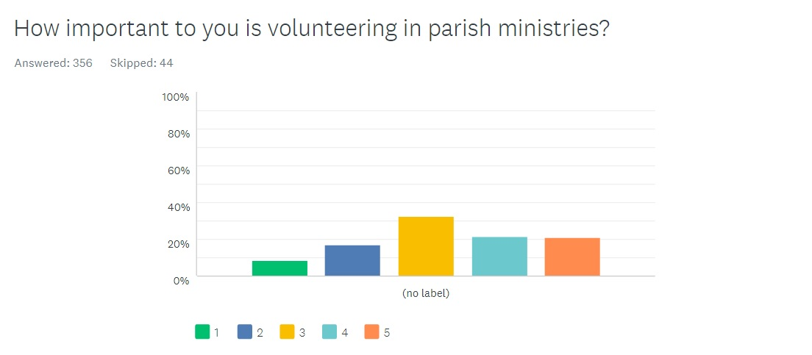

Slide 43
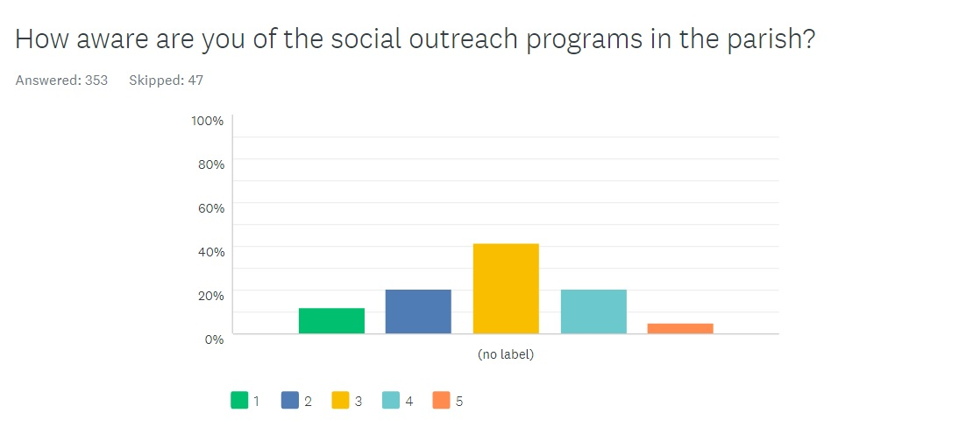

Slide 44
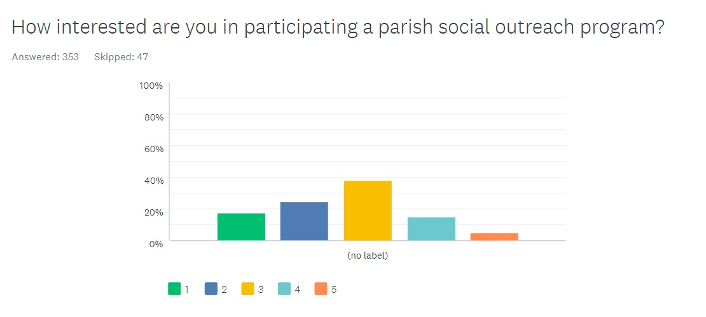

Slide 45
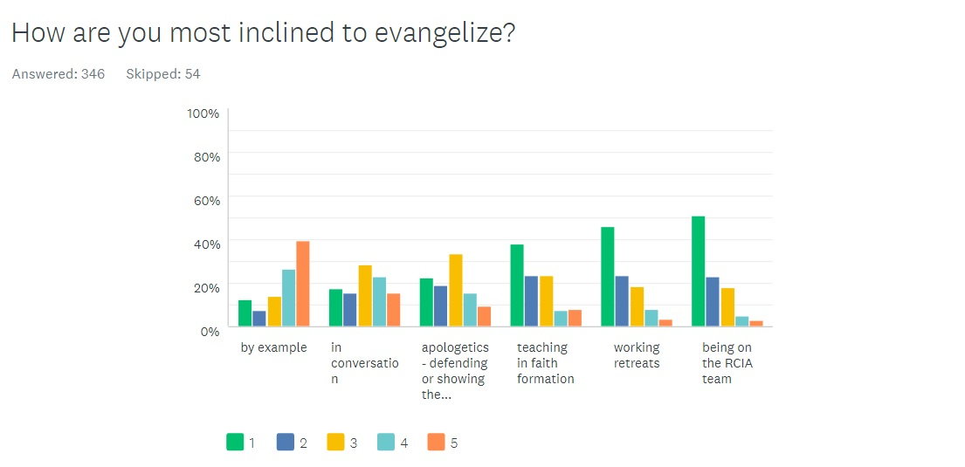

Slide 46
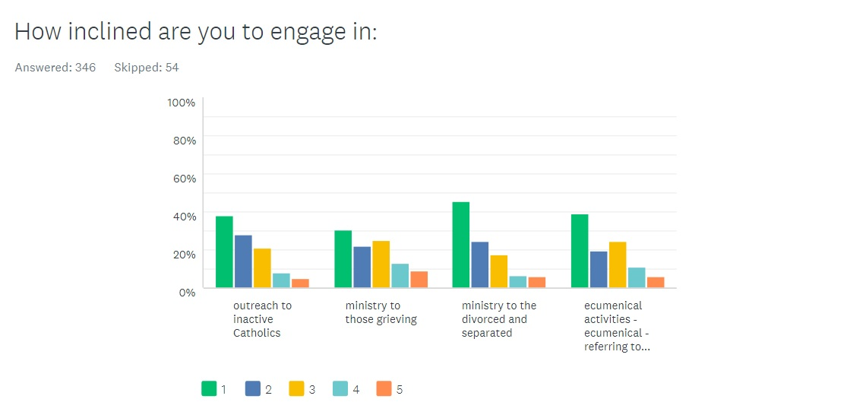

Slide 47
How do we want to build on our solid foundation?

Slide 48
Financial and Demographic Data
Steve Mizner

Slide 49
Mass Count Trends
Mass Attendance Data
[2002-2018]
Change -53.2%
[2008-2018]
Change -41.3%
Avg. Change/yr
['02-'18] -4.5%
[08-'18] -4.3%
Crawford County Census Data
Location 2000 2010 2017
Meadville City 13,685 13,388
Vernon Twp 5,449 5,630
West Mead Twp 5,227 5,249
Crawford County 90,348 86,159 -4.64%
Total (2000-10) 24,361 24,267 -0.39%

Slide 50
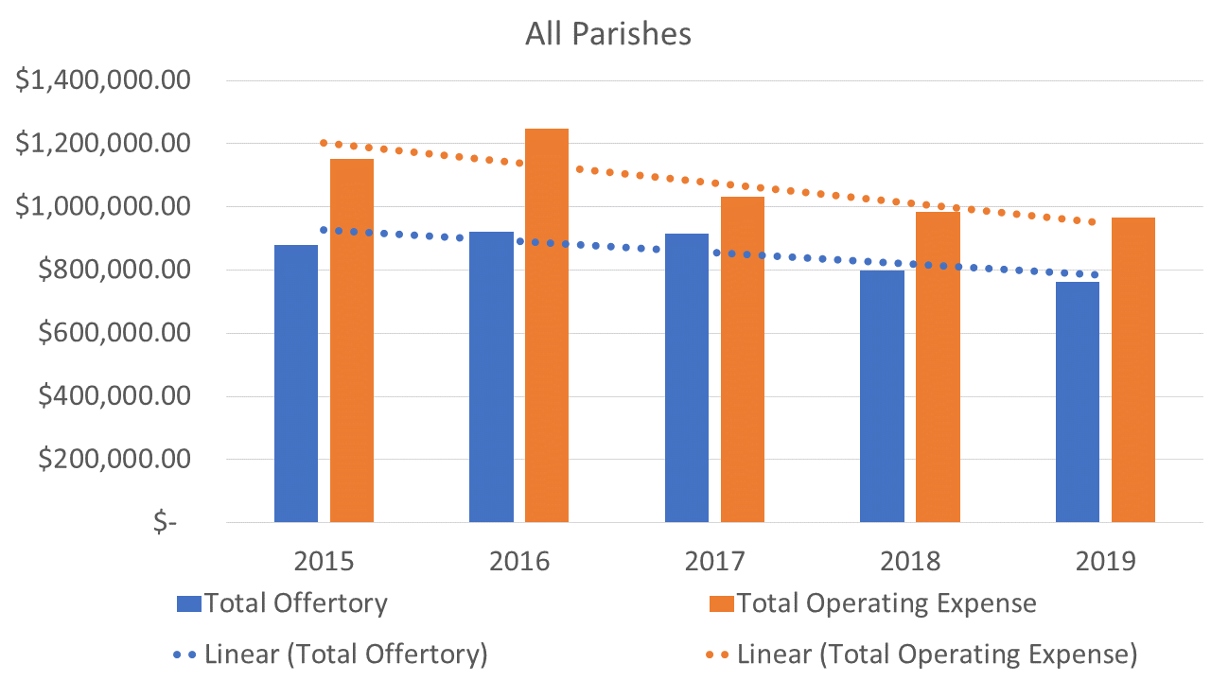
Offertory and Operating Expenses

Slide 51
Giving
Weekly Envelope Average per household
2015-$18.27 per week
2019-$18.80 per week
Change +3%
Annual Average Household Giving
2015-$950 per year
2019-$978 per year
Change +2.9%

Slide 52
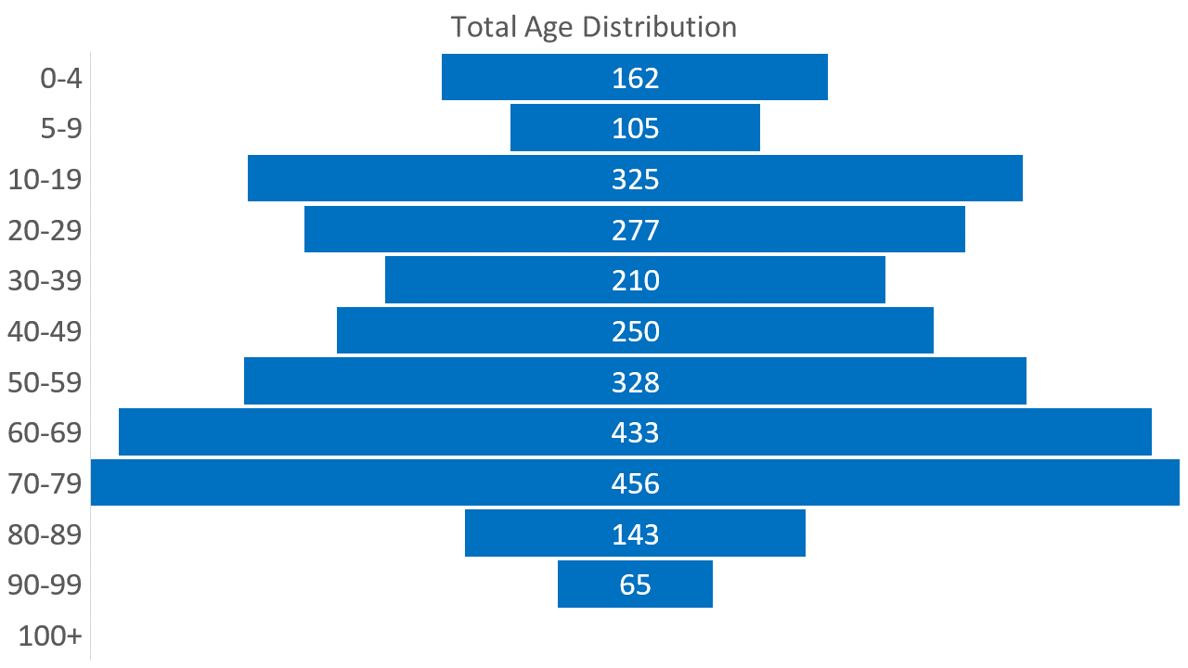
Age Distribution

Slide 53
Households Registered
2015 Registered Households 1,463 (members-3,692)
2019 Registered Households 1,377 (members -2,867)
Change in Households -6% (members -22%)

Slide 54
Sacramental Statistics
2015 2019
Baptisms 29 24
First Communions 37 40
RCIA 8 5
Marriages 16 11
Deaths 83 63

Slide 55
Diocesan Statistics
As of 2019 there are 97 parishes
Number of Active Priests
2015-121
2019-about 110 (of which only 29 are under the age of 40)
2025-projected total of 76

Slide 56
Significant Changes for Meadville
2016 Catholic Community of Meadville Formed with:
One Pastor and One Parochial Vicar
One Pastoral Council
One Finance Council

